Slide 1

FACE DETECTION AND RECOGNITION
SUBMITTED BY: SUPERVISOR:
PRANJUL PAL(1805210035) Dr. MANIK CHANDRA
YASH JAISWAL(1805210064) Ms. MUDITA SHARAN
ZIYAUDDIN(1805210067)

Slide 2
CONTENTS
INTRODUCTION
MOTIVATION
OBJECTIVES
TOOLS AND TECHNOLOGIES
METHODOLOGY
IMPLEMENTATION
FACE DETECTION
DATA GATHERING AND TRAINING
FACE RECOGNITION
APPLICATIONS
CONCLUSION
REFERENCES

Slide 3
INTRODUCTION
The face is one of the easiest ways to distinguish the individual identity of each other.
Person is identified in two phases:
Face Detection: Detecting the human face based on facial features.
Face Recognition: Recognizing face as individuals.

Slide 4
MOTIVATION
Face recognition has recently received blooming attention and interest from the scientific community as well as from the general public.
The demands for the useful security systems is gradually increasing day-by-day.
To construct these different applications, precise and robust automated facial recognition methods and techniques are needed.
Notes:
There are several reasons for recent increased interest in face recognition, including rising public concern for security, the need for identity verification in the digital world, face analysis and modelling techniques in multimedia, data management and computer entertainment

Slide 5
OBJECTIVES
In this project, we had work on the problem of face detection and recognition of an individual.
Our project is capable of detecting the human face.
Further, it is capable of recognising those human faces whose data we have collected already.

Slide 6
TOOLS AND TECHNOLOGIES USED
Python Programming Language
Django Framework: Django is a free and open source back-end server side web framework written in Python. It makes it easier to build web pages using Python.
OpenCV: It is an open-source library that can be used to perform image processing and performing computer vision tasks.
Haar Cascades: It is a machine learning based approach where a cascade function is trained from a lot of positive and negative images. It is then used to detect objects in other images.
Local Binary Pattern Histogram(LBPH): It is a Face-Recognition algorithm, used to recognize the face of a person. It is able to recognize the face of a person from both front face and side face.

Slide 7
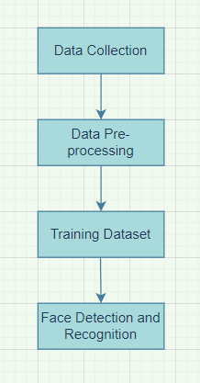
METHODOLOGY
Creation of the Dataset
Pre-processing Dataset
Training of the Dataset
Detection of Human Face
Recognition of Human Face

Slide 8
IMPLEMENTATION
Camera Setup
In-built camera is used for images input.
OpenCV libraries are used to resize and convert the images to grayscale.
Haar Cascade Classifier:
It is an effective machine learning object detection program that identifies objects in an image and video quickly and in real-time.
Cascade function is trained by a lot of positive and negative images.
The cascade classifier consists of stages, which are trained using the technique called boosting.

Slide 9
FACE DETECTION
Images are converted to grayscale to avoid false complexities and classifications.
Installed pre-trained haar cascade classifier for face detection in XML format and stored it in separate folder.
Gathered the positions of all the faces found by the classifier and marked them with rectangles.
Additionally, classifiers can also find eyes and smile positions of each face with additional classifiers.

Slide 10
DATA GATHERING
Created dataset by clicking 800 pictures for a particular user at once and saving the cropped face grayscale image in the dataset folder.
Each image will be saved as:
User.face_id.count.jpg
where, face_id = User’s id
count = Number of images saved for a particular id
More number of images increases the accuracy of the model.

Slide 11
DATA TRAINING
LBPH (Local Binary Patterns Histogram) Algorithm:
In this project we are using LBPH algorithm to train our dataset for face recognition.
It is a face recognition algorithm based on a local binary operator, design to recognise both the side and front face of a human.
LBPH Algorithm has some limitation such as expression diversification, disorientation and change in lighting performance.
After the training process trainer.yml file will be created and saved in the trainer directory.

Slide 12
LBPH ALGORITHM (CONT.)
LBPH Algorithm mainly use four parameters:
Radius: Distance of the circular local binary pattern from the center pixel to its circumference.
Neighbors: Number of data points within a circular local binary pattern.
Grid X: No. of cells in horizontal plane.
Grid Y: No. of cells in vertical plane.
It makes use of the dataset of the images of the people to be included in the recognition process. Each image is given a unique ID so that the algorithm can use this information to identify the image and export the output.

Slide 13
FACE RECOGNITION
This is the final step in which we will capture a fresh face on camera and if the model is trained on the person’s face, our recogniser will make a prediction returning its id.
There is also a parameter named confidence which shows the percentage match with the trained images.
If recogniser could predict a face then we put a text over the image with their id and can put the number showing the percentage probability of the match.

Slide 14
APPLICATIONS
To prevent crimes.
For unlocking mobile phones
For accessing bank vaults, labs, offices etc.
In finding missing persons.
Identifying people on social media.
For marking attendance.

Slide 15
CONCLUSION
We emphasize the important role of OpenCV in face detection and recognition. We illustrate the popular algorithms in OpenCV that are used for face detection and recognition. Then state the OpenCV modules and explain OpenCV based on Python.
This project mainly focuses on recognising the person in the camera. The program take set of images and use that images to train the dataset and output the name of person who are seen in the real-time video.
There are few limitations in this project as user have to train the machine beforehand only then it will be able to recognise the person.

Slide 16
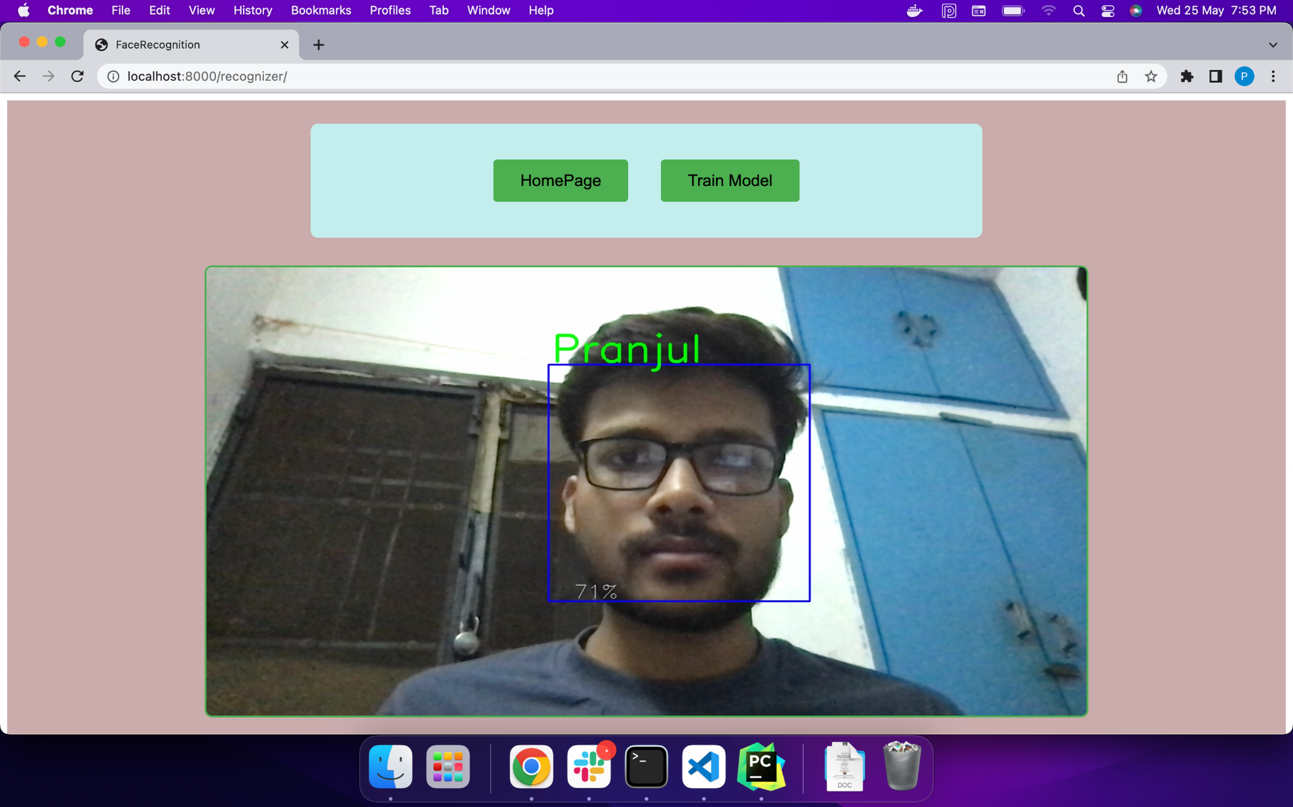
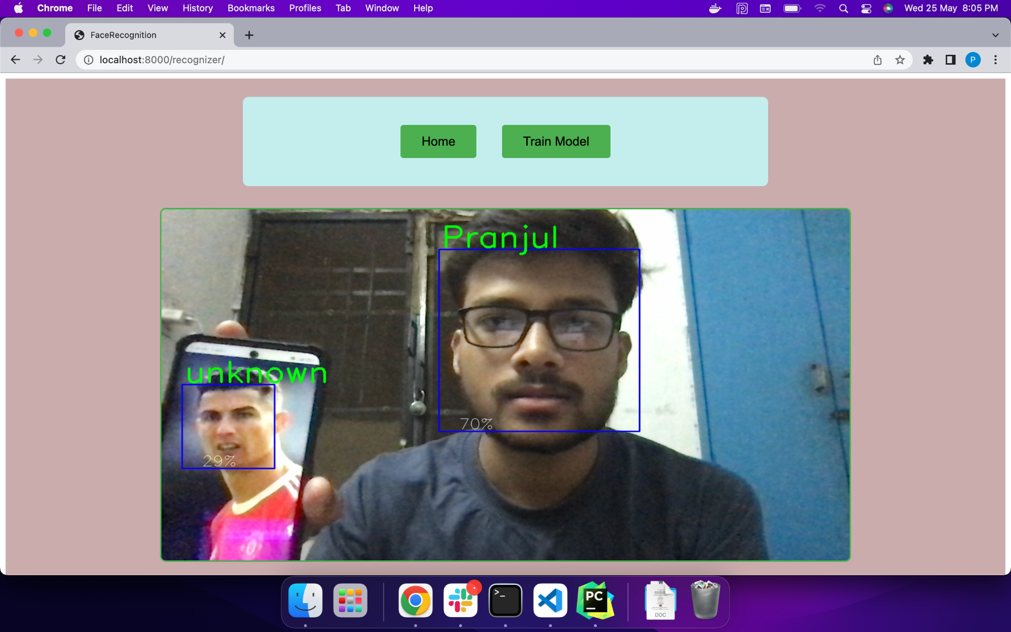
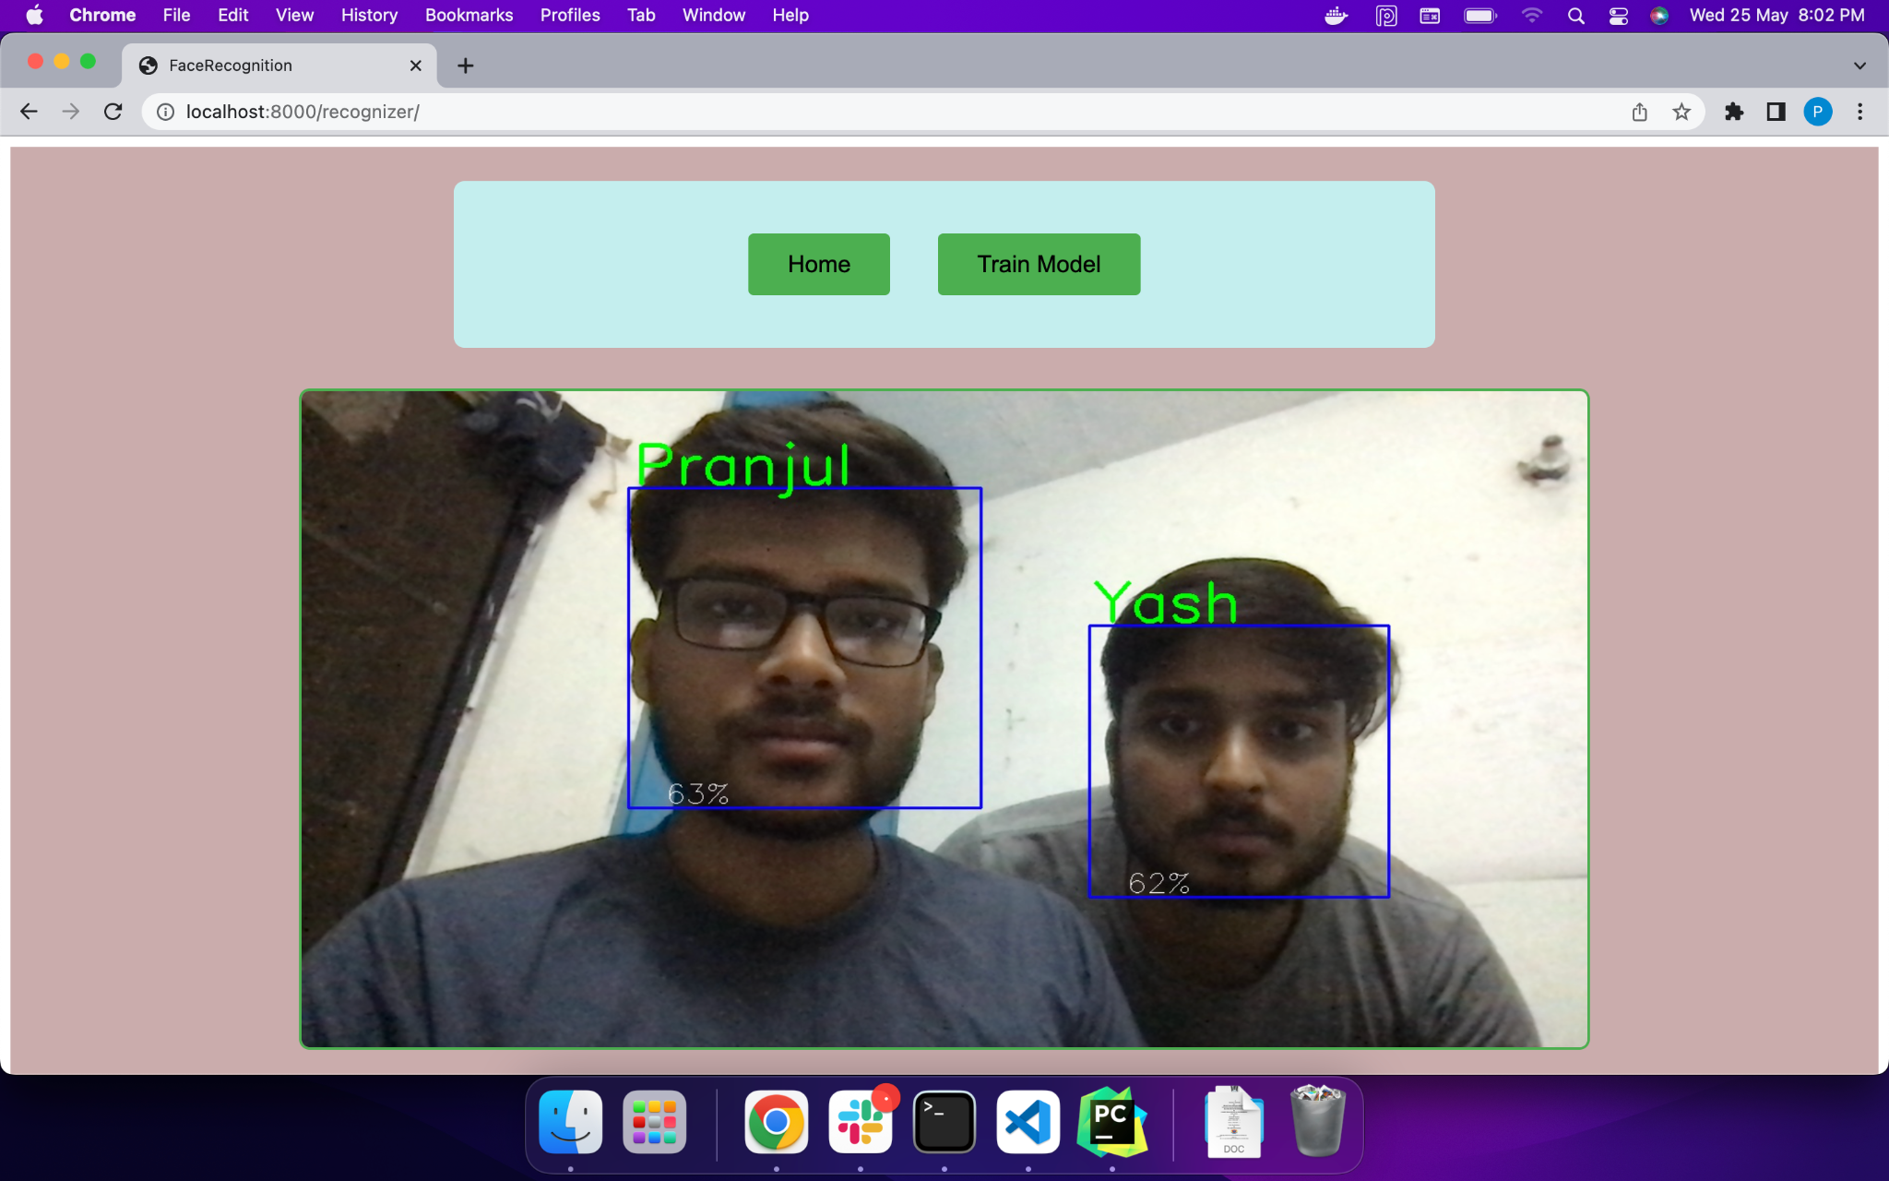

Slide 17
REFERENCES
T Ojala, M Pietikainen and T. Maenpaa, "Multiresolution gray-scale and rotation invariant texture classification with local binary pattern [J]", IEEE Transactions on Pattern Analysis and Machine Intelligence, vol. 24, no. 7, pp. 971-987, 2002.
B. Mandal, "Face recognition: Perspectives from the real world [C]", IEEE 2016 14th International Conference on Control Automation Robotics and Vision (ICARCV), pp. 1-5, 13-15 Nov. 2016.
https://www.researchgate.net/publication/355886757_Face_Detection_and_Recognition_Using_OpenCV
https://en.wikipedia.org/wiki/Facial_recognition_system
https://docs.opencv.org/3.4/db/d28/tutorial_cascade_classifier.html
https://medium.com/analytics-vidhya/haar-cascades-explained-38210e57970d
https://www.kite.com/python/docs/numpy

Slide 18
THANK YOU!

